Slide 1

Introduction to Ecological Niche Modeling

Slide 2
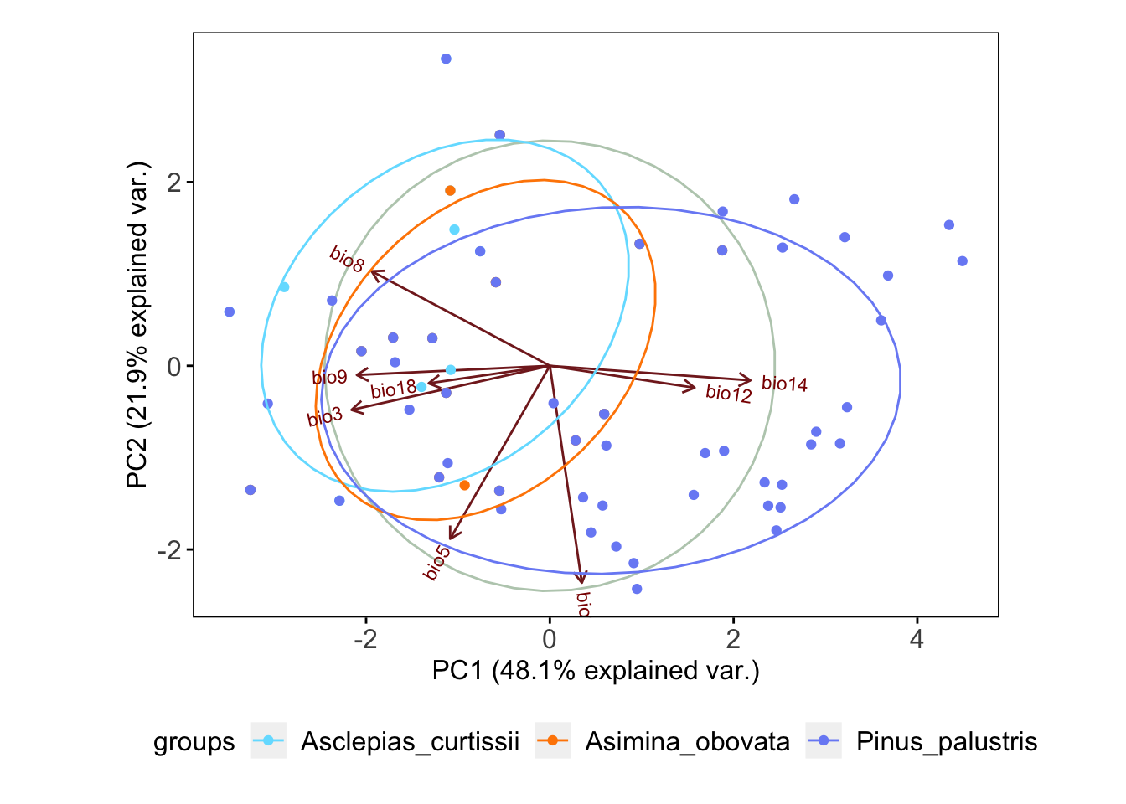
Ecological Niche
Realized Niche
abiotic conditions that a species can occupy with the presence of biotic interactions
Fundamental Niche
abiotic conditions a species could potentially occupy in the absence of biotic interactions

Slide 3
Ecological Niche
Realized Niche
abiotic conditions that a species can occupy with the presence of biotic interactions
Fundamental Niche
abiotic conditions a species could potentially occupy in the absence of biotic interactions
“it is defined in multidimensional ecological space (MacArthur 1972).” – Peterson 2001

Slide 4
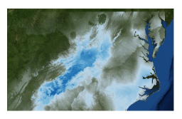
Ecological Niche Modeling
MaxEnt
uses the principle of maximum entropy on presence-only data to predict the species’ potential geographic distribution (or niche)

Slide 5
MaxEnt
MaxEnt used only presence and pseudo-absences for model development
No ”best” algorithm for modeling (Qiao, H. , Soberón, J. and Peterson, A. T. (2015) Methods Ecol Evol), but MaxEnt generally performs well across evaluation criteria (Aguirre-Gutierrez et al (2013) PLoS One)
What does it do?
Makes prediction for each cell on the landscape.
Models should be chosen that are as similar as possible to prior expectations while also being consistent with the data
Important notes:
The grids must all have the same geographic bounds and cell size (i.e. all the ascii file headings must match each other perfectly)

Slide 6
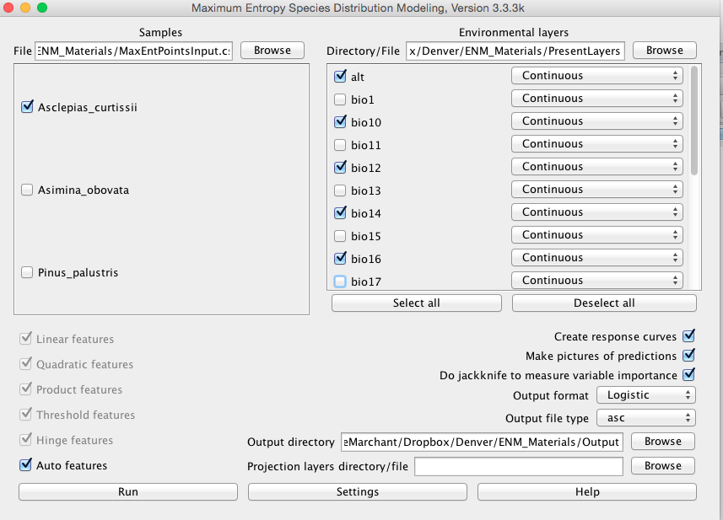
Select only non-correlated layers
**For the demo you only have non-correlated layers**
Only one species at a time
Select output directory

Slide 7
gives an estimate between 0 and 1 of probability of presence

Slide 9
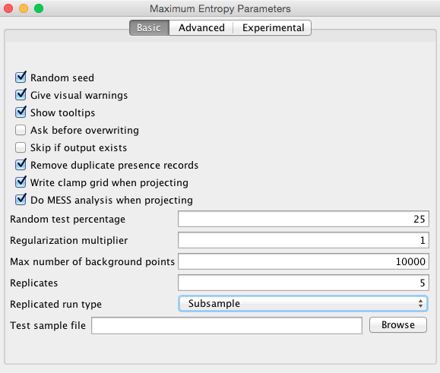
Subsample: in which the presence points are repeatedly split into random training and testing subsets
Bootstrapping: where the training data is selected by sampling with replacement from the presence points

Slide 11
Clamping treats variables outside the training range as if they were at the limit of the training range.
Clamp grid depicted are the absolute difference between predictions with and without clamping.

Slide 12
MESS = Multivariate Environmental Surface Similarity (MESS)

Slide 13
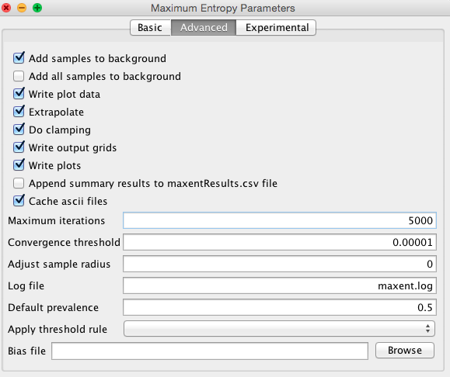
Extrapolate = extent to estimate
Iterations = allows the model to have adequate time for convergence (coming together)

Slide 14
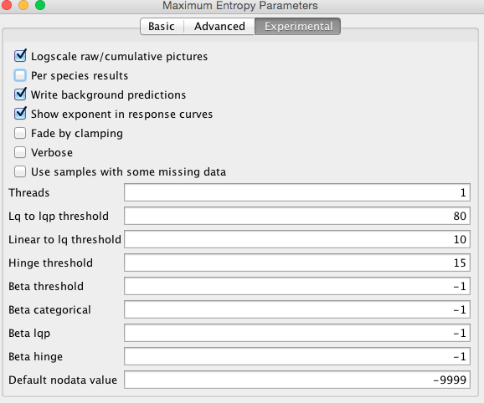

Slide 16
Ecological Niche Modeling in R
Must have rJava installed –
This is often tricky!
We provided scripts, but will not demo MaxEnt in R

